Slide 1
CSI Bundle
Ver 1.0

Slide 2
Bundle
It’s all about persuade player to buy more
Aim:
Increase sales by selling cost-efficient bundles
UI Impacted: Shop
Add a bundle page with different item size and layout

Slide 3
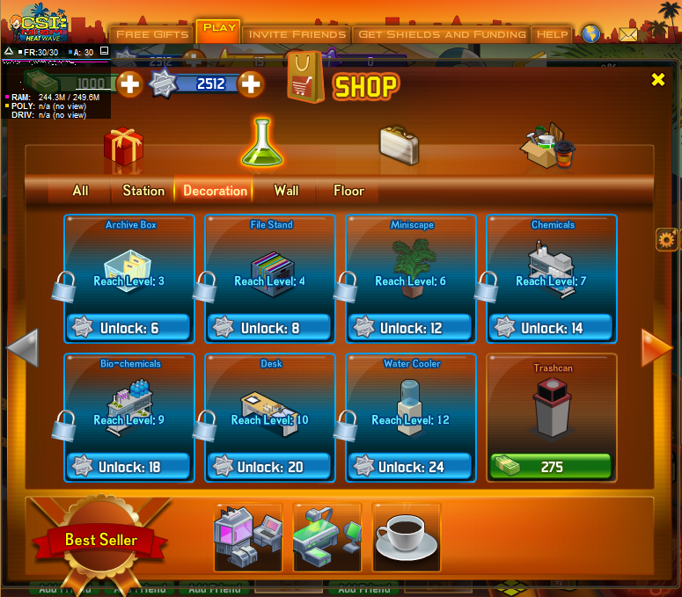








UI: Bundle Tab
Supply Pack
Resource Pack
Energy Pack
15
15
1500
20
15
15
5
300
300
300

Slide 4
UI: Mouse over bundle item
Revealer
Use to process evidence. Produce with any green station.
Supply Pack
Resource Pack
Energy Pack
15
15
1500
20
15
15
5
300
300
300

Slide 5
UI: Size

